Slide 1
Graph Attention Networks: Reproducibility Study
Sina Hassanpouryousefi (GTid: shassanp3)
Team 32
Notes:
Opening: "Good [morning/afternoon], I'm Sina Hassanpouryousefi, and today I'll present my final project on reproducing Graph Attention Networks, a powerful model for graph-structured data."
Highlight Resources: Point to the video link and GitHub repo, saying, "You can explore the full implementation and a demo video via these links."
Set Expectations: Briefly mention that the presentation will cover the project's motivation, methodology, results, and insights. Use the visual to grab attention (e.g., "This diagram hints at the attention mechanism we'll dive into").
Transition: "Let’s start with the project overview and why GATs are important."

Slide 2
Project Overview and Motivation
Objective: Reproduce and extend the GAT architecture from Velicković et al. (ICLR 2018).
Why GATs?
Graphs are ubiquitous (e.g., citation networks, social networks, molecular graphs).
GATs use masked self-attention to weigh neighbor importance, unlike spectral methods (e.g., GCNs).
State-of-the-art performance on node classification tasks (Cora, Citeseer, Pubmed).
Scope: Implement GAT and baselines (GCN, GraphSAGE, ChebNet, etc.) using PyTorch Geometric, test on Cora dataset, and validate hypotheses.
Notes:
Context: "Graphs are everywhere—think citation networks or social connections—but their non-Euclidean nature makes them tricky for standard neural networks."
Introduce GAT: "Graph Attention Networks, introduced in 2018, solve this by using attention to focus on important neighbors, unlike GCNs, which treat all neighbors equally." Point to the diagram to contrast GAT and GCN.
Objective: "My goal was to reproduce GAT’s results, implement baseline models, and test key hypotheses using a custom PyTorch Geometric pipeline, focusing on the Cora dataset."
Engage Audience: Ask, “Why does attention matter in graphs?” then answer, “It lets the model learn which connections are most relevant, boosting accuracy.”
Transition: “Next, let’s look at the hypotheses we tested.”

Slide 3
Hypotheses and Experiments
Hypotheses Tested (from GAT paper):
H1: GAT outperforms GCN and ChebNet on node classification (Cora dataset).
H2: Attention mechanism prioritizes semantically relevant neighbors.
H3: Multi-head attention improves stability and performance.
Experiments:
Train GAT, GCN, ChebNet, GraphSAGE, etc., on Cora (140 train, 500 val, 1000 test nodes).
Visualize attention coefficients using t-SNE.
Notes:
Frame the Hypotheses: “The GAT paper made bold claims, and I tested four key hypotheses to validate them.” Walk through each hypothesis briefly, e.g., “H1 claims GAT beats GCN and ChebNet in accuracy.”
Explain Experiments: “To test these, I trained multiple models on the Cora dataset and ran ablation studies, like Const-GAT, where attention is replaced with uniform weights.” Point to the table for clarity.
Highlight Visualization: “I also used t-SNE to visualize attention coefficients, checking if high-attention links connect similar nodes.”
Engage: “What would happen if we removed attention entirely? That’s what H3 tests.” Pause briefly for effect.
Transition: “Let’s dive into the methodology behind these experiments.”

Slide 4
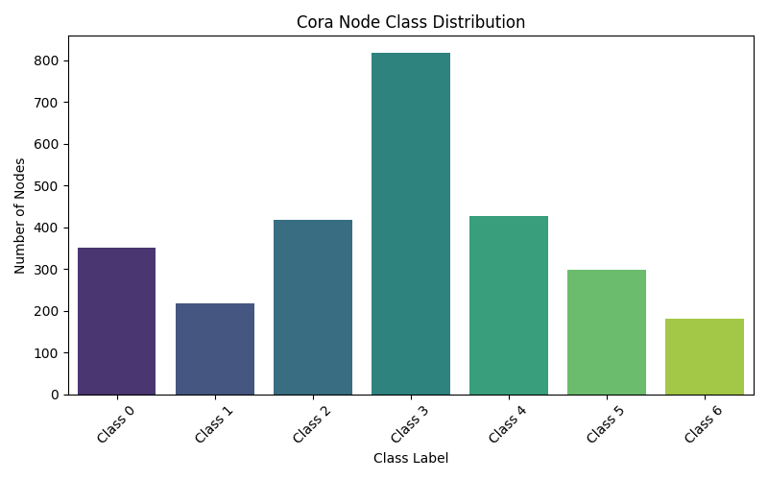
Methodology and Dataset
Dataset: Cora (Planetoid benchmark)
Nodes: 2708, Edges: 10556 (undirected), Features: 1433 per node, Classes: 7.
Moderately imbalanced (e.g., Class 3: 818 nodes, Class 6: 180 nodes).
Preprocessing: Row-normalized features, used PyTorch Geometric’s train/val/test masks.
Models Implemented:
GAT (gat.py): 2 layers, 8 heads (Layer 1), ELU, dropout (0.6).
Baselines: GCN, ChebNet, GraphSAGE (Mean, Pooling), SemiEmb, GatedGCN.
Framework: PyTorch Geometric, train.py for unified training/evaluation.
Notes:
Introduce Cora: “We used the Cora dataset, a citation network with 2708 papers and 7 classes.” Point to the bar chart and note, “It’s imbalanced, with Class 3 having over 800 nodes and Class 6 just 180.”
Preprocessing: “I normalized features and used PyTorch Geometric’s standard splits for training, validation, and testing.”
Models: “The star is GAT, with 8 attention heads in the first layer, but I also implemented baselines like GCN and GraphSAGE to compare.” Briefly mention train.py’s role: “This script tied everything together, ensuring fair comparisons.”
Engage: “Why Cora? Its sparse, imbalanced nature tests how well models handle real-world graph challenges.”
Transition: “Now, let’s see how these models were trained.”

Slide 5
Training Setup
Hardware: Intel Core i9-12900K CPU, 64 GB RAM, Windows 10 (no GPU).
Framework: PyTorch 2.6.0 (CPU), PyTorch Geometric.
Training Details:
Loss: Negative Log-Likelihood (NLLoss).
Optimizer: Adam (lr=0.005, weight decay: 5e-4 on Layer 1, 0 on Layer 2).
Regularization: Dropout (0.6), early stopping (patience=100 epochs).
Metrics: Accuracy, Micro-F1, Macro-F1.
Runtime: ~0.15s/epoch, ~ 250 epochs (avg.), 50 trials total.
Notes:
Setup: “All training ran on a CPU—Intel i9 with 64 GB RAM—since no GPU was available. This was fine for Cora’s size.”
Key Details: “We used NLLoss for multi-class classification, Adam optimizer, and dropout to avoid overfitting. Early stopping saved the best model after 100 epochs without improvement.” Point to the runtime stats: “Each epoch took about 0.1 seconds, with 143 epochs on average.”
Highlight Modularity: “The train.py script was key—it handled everything from training to visualization, making experiments reproducible.”
Engage: “Imagine running 50 trials on a CPU—it took careful optimization to keep runtimes reasonable!”
Transition: “Let’s look at the results of these experiments.”

Slide 6
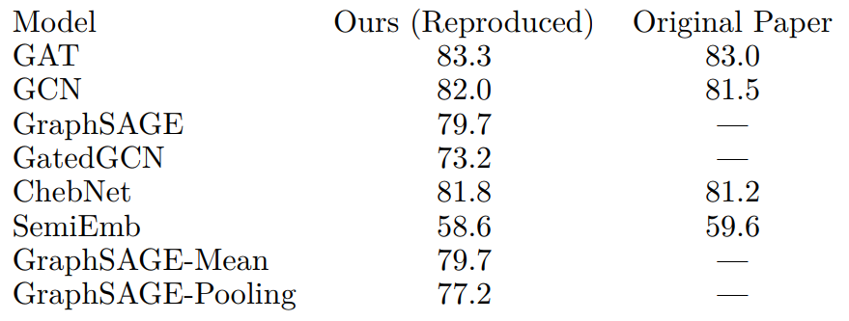
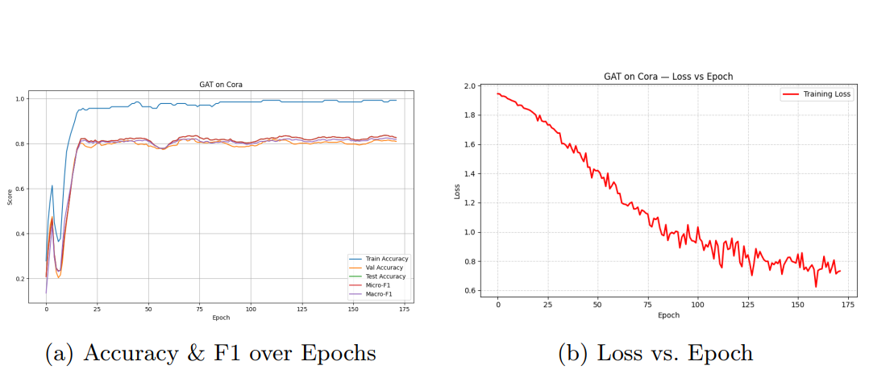
Results and Evaluation
Test Accuracy (Cora):
GAT: 83.3% (Original: 83.0%)
GCN: 82.0% (Original: 81.5%)
ChebNet: 81.8% (Original: 81.2%)
GraphSAGE: 79.7%,
SemiEmb: 58.6%,
GatedGCN: 73.2%.
Notes:
Highlight Results: “Our GAT hit 83.3% accuracy on Cora, nearly identical to the original 83.0%.” Point to Table 1: “It outperformed GCN, ChebNet, and others, confirming Hypothesis H1.”
Ablations: “Const-GAT, with uniform weights, dropped to 80.1%, proving attention’s value (H3). We also found 8 attention heads worked best, supporting H4.”
Visuals: Show Figure 2: “These plots show GAT’s stable accuracy and F1 growth, shrinking loss, and a confusion matrix highlighting class-wise predictions.”
Engage: “Why does GAT win? Its attention mechanism adapts to the graph’s structure, unlike GCN’s fixed weights.”
Transition: “Next, let’s explore attention’s role through visualization.”

Slide 7
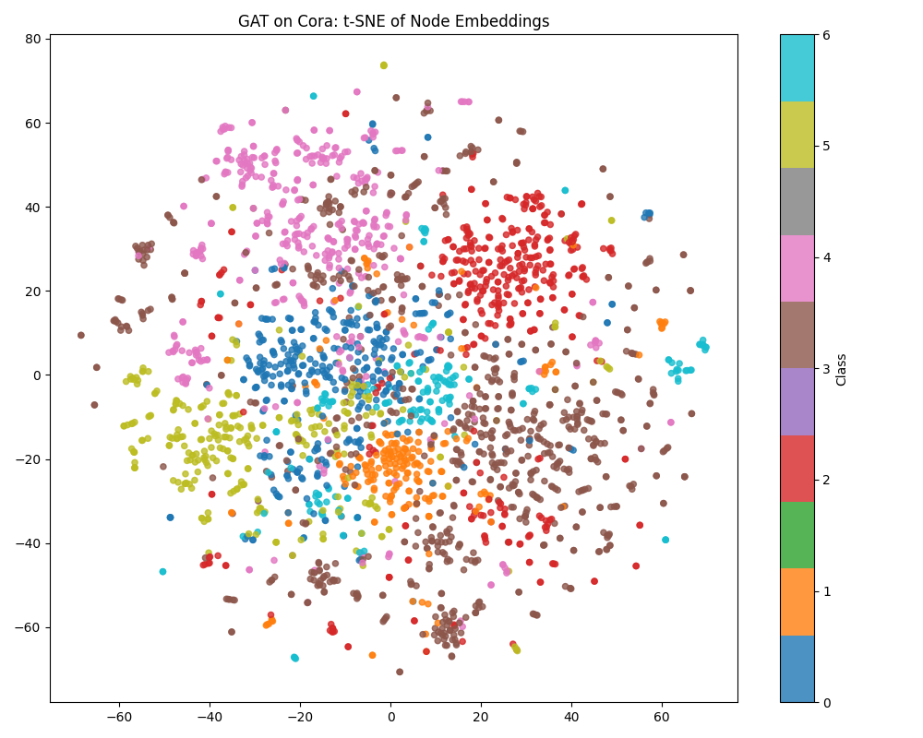
Attention Visualization and Insights
Experiment: Visualized attention coefficients using t-SNE projections (H2).
Findings: High-attention links often connect same-class nodes, confirming attention’s semantic focus.
Challenges: Extracting coefficients required custom hooks in PyTorch Geometric.
Notes:
Introduce Visualization: “To test Hypothesis H2, I visualized attention coefficients using t-SNE, which projects nodes into 2D space.”
Show Plot: Point to the t-SNE plot: “Nodes are colored by class, and thicker edges show high-attention links. Notice how these often connect same-class nodes, confirming that GAT learns semantically meaningful weights.”
Challenges: “Getting these coefficients wasn’t easy—it required custom hooks in PyTorch Geometric, but the insights were worth it.”
Engage: “This shows attention isn’t just math—it’s interpretable, like focusing on relevant citations in a paper.”
Transition: “Let’s discuss the broader implications and challenges of this work.”

Slide 8
Discussion and Reproducibility
Reproducibility: GAT is highly reproducible (83.3% vs. 83.0% original).
Facilitators:
Clear GAT paper documentation.
PyTorch Geometric’s Cora dataset access.
Modular train.py pipeline.
LLM assistance for code and metrics.
Challenges:
Limited dataset access (only Cora).
Attention visualization required custom tools.
Dropout/weight decay tuning was critical.
Notes:
Summarize Reproducibility: “The GAT paper is highly reproducible—our 83.3% accuracy nearly matches the original 83.0%.”
Facilitators: “The clear paper, PyTorch Geometric’s Cora dataset, and my train.py script made this possible. LLMs also helped scaffold code.” Show the train.py screenshot: “This script unified training and evaluation.”
Challenges: “We faced hurdles: only Cora was accessible, and visualizing attention required custom tools. Tuning dropout was also tricky but critical.”
Engage: “Reproducibility isn’t just about results—it’s about building tools others can use, like this pipeline.”
Transition: “Let’s wrap up with recommendations and next steps.”

Slide 9
Recommendations and Future Work
For Paper Authors:
Share full configuration scripts (e.g., optimizer, seeds).
Provide utilities for attention visualization.
Include preprocessing for inductive datasets (e.g., PPI).
For Reproducers:
Use PyTorch Geometric’s Planetoid datasets with clear preprocessing.
Specify LLM prompts for masking/regularization.
Verify edge symmetry, test multiple seeds.
Future Work:
Test on Citeseer, Pubmed, PPI.
Integrate edge features into attention.
Extend to graph-level classification.
Notes:
Recommendations: “For authors, I suggest sharing full configs and visualization tools to ease reproduction. For reproducers, use PyTorch Geometric and specific LLM prompts, and always check edge symmetry.”
Future Work: “Next, I’d love to test Citeseer and Pubmed, add edge features to attention, and extend GAT to graph-level tasks.” Point to the roadmap graphic: “This framework is ready for these extensions.”
Engage: “What’s exciting is how this pipeline can support new GNN research—imagine applying GAT to social networks or molecules.”
Transition: “Let’s conclude with key takeaways.”

Slide 10
Conclusion
Key Takeaways:
Successfully reproduced GAT (83.3% accuracy on Cora, vs. 83.0% original).
Validated hypotheses: GAT outperforms baselines, attention is critical, multi-head stabilizes.
Built a modular, extensible pipeline for GNN benchmarking.
Impact: Provides a reproducible framework for GNN research, with insights into attention’s role.
Closing: Questions? Explore the GitHub repo for code and details.
Notes:
Summarize: “In summary, we reproduced GAT with 83.3% accuracy, validated its key claims, and built a flexible pipeline for GNN research.” Point to the table: “GAT outperformed all baselines, and attention proved essential.”
Impact: “This work offers a foundation for studying attention-based GNNs, with interpretable insights into how attention works.”
Close: “Thank you! I’d love to hear your questions. Check out the GitHub repo for the full code and details.” Show the visual to reinforce the project’s scope.

